Slide 1

INFO3005 Security & Information Technology
Risk Analysis

Slide 2
"Problems aside, we are rapidly approaching a situation where risk management is no longer an option.
In a highly competitive business environment, companies cannot afford to have costly or inappropriate security.
Effective risk management can be nothing less than the defence of company profitability."
- Dr P G Dory, former Head Of Information Security, Barclays Bank PLC

Slide 3
Today's Programme
Risk Analysis
Physical Control

Slide 4
Reminder:
Security Administration consists of:
Planning (last time)
Risk Analysis
Policy (last time)
Back-up (last time)
Physical Security

Slide 5
Risk Management

Slide 6
General Risk management
Risk management is concerned with identifying risks and drawing up plans to minimise their effect on a project.
A risk is a probability that some adverse circumstance will occur
Project risks affect schedule or resources;
Product risks affect the quality or performance of the software being developed;
Business risks affect the organisation developing or procuring the software.

Slide 7
Risks are not necessarily bad.
As long as the benefits are commensurate with the risk.
In general, three factors increase the risks of a project:
project size,
organisational experience,
and project task complexity.

Slide 8
Why do we need to do a risk analysis
Ok in to groups
Take 3 minutes to discuss this question

Slide 9
Why do we need to do a risk analysis
To Protect
Company Assets
Company Brand
Employee Productivity
Lost productivity due to lack of business continuity
Compliance with Security Regulations
Regulatory bodies

Slide 10
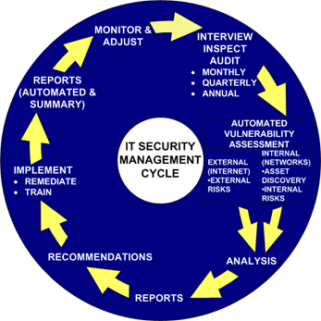
Security Risk Assessments
http://www.esecuritytogo.com/ccpage.aspx?pageid=7&name=security_risk_management&lid=11&lgid=1

Slide 11
Reminder about Planning:
OK, so we spend a lot of time and effort on planning for all sorts of things that may never happen – then the one thing we never thought of happens...
On the other hand, thinking ahead with a clear mind is easier than responding on the fly in confusion

Slide 12
Risk Analysis
Three components:
Risk impact (i.e. Potential loss)
Probability of occurrence
Risk control (means to minimise risk)
Mitigations, just like any other risk plan

Slide 13
Risk analysis
Assess probability and seriousness of each risk.
Probability (P) may be very low (1), low (2), moderate (3), high (4) or very high (5).
Risk effects (E) might be catastrophic (5), serious (4), tolerable (2) or insignificant (1).
To give an overall rating, (a number, P x E)

Slide 14
Quantitative Risk Analysis
risk impact x risk probability = risk exposure
e.g. A potential virus attack:
£10K loss x 0.3 probability of happening = £3K exposure
so spending £100 on a virus-checker may be a good idea!
Notes:
Not just for show, the do occur
Small business, 2k would make it still good

Slide 15
Quantitative Risk Analysis
rank events in order of Exposure
sometime called Annual Loss Expectancy (ALE)' or the 'Estimated Annual Cost (EAC)'.
Can promote complacency
Probability is just that probability not certainty
Controls and countermeasures often tackle a number of potential events
Event are often interrelated
Yet still important to do
Notes:
Not just for show, the do occur
Small business, 2k would make it still good

Slide 16
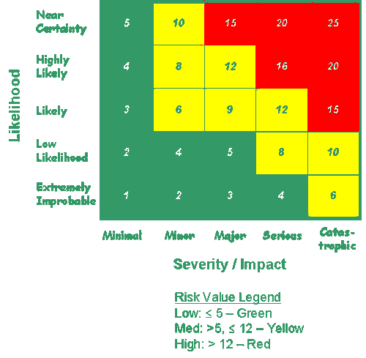
Quantitative Risk
http://www.faa.gov/about/office_org/headquarters_offices/ato/service_units/operations/isse/items/e-Dev-Prem-Vul-Risk-assessment.cfm?print=go

Slide 17
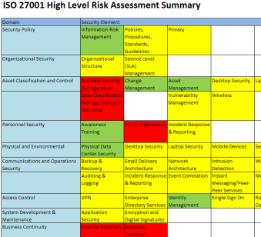
Quantitative risk assessment

Slide 18
Risk Analysis
Three strategies:
Avoidance
buy the virus checker
Transference
Make it the user's responsibility to install a virus checker, or
Take out a virus insurance policy
Assumption
i.e. Assume the risk, control it, prepare to deal with consequences
Notes:
Assume all virus are caught
Someone else's problems, user responsibility
Assumption: Policy that operating system is always up to date, we assume that the holes are plugged. Our procedures will deal with the virus attack.

Slide 19
Risk Analysis
Risk Leverage:
Need a high-enough value before undertaking this risk reduction
Risk exposure before –Risk exposure after
Cost of reducing the risk
Notes:
How useful it is to take the measure, how much am I exposed now I have take this action

Slide 20
Qualitative Risk Analysis
only estimated potential loss is used
Use a number of interrelated elements:
THREATS
Deliberate manipulation of information prior to input/processing
Impersonation of a legitimate user
Untrained or poorly trained staff
VULNERABILITIES
Poor website or network design (e.g. which can allow "hackers" into a system or web site)
Poor recruitment procedures
Notes:
Threats These are things that can go wrong or that can 'attack' the system. Examples might include fire or fraud. Threats are ever present for every system.
VULNERABILITIES: These make a system more prone to attack by a threat or make an attack more likely to have some success or impact.
Risks do not arise all by themselves. A risk is normally a product of two factors: threats(something could go wrong) and vulnerabilities (the information system/s used by the business will allow things to do wrong).

Slide 21
Qualitative Risk Analysis
CONTROLS
Deterrent controls reduce the likelihood of a deliberate attack
Preventative controls protect vulnerabilities and make an attack unsuccessful or reduce its impact
Corrective controls reduce the effect of an attack
Detective controls discover attacks and trigger preventative or corrective controls.

Slide 22
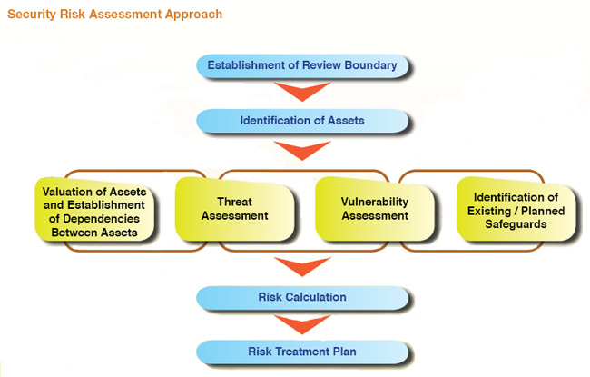
Risk Analysis
http://www.scan-associates.net/services_risk.htm

Slide 23
Risk Analysis
Basic steps:
Identify assets
Determine vulnerabilities
Estimate probability of occurrence
Compute potential loss (inc. on-going)
current operations and staff leave, competition
Survey possible controls + associated costs
Predict savings (inc. on-going)
Notes:
Loses; also includes loss of current operations and staff leave, competition

Slide 24
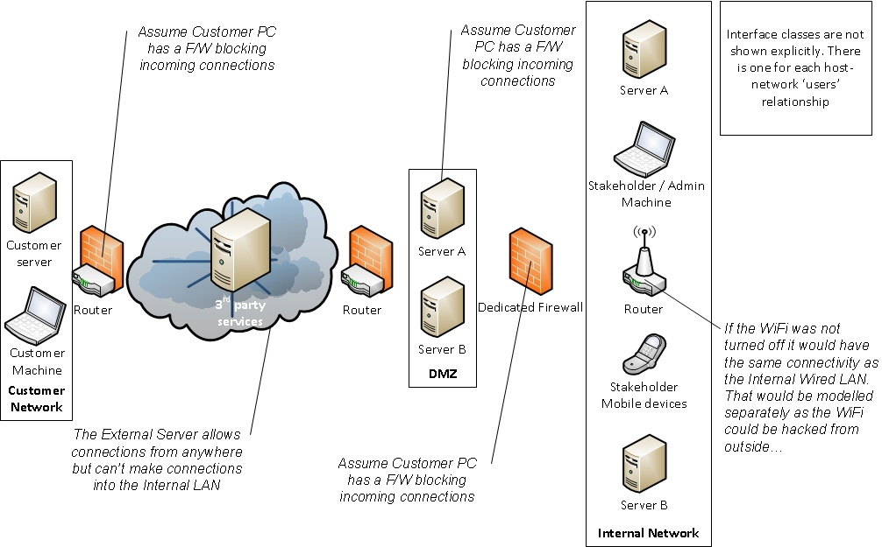

Slide 25
SQL Injection Threat Modelling – Control View (Option 1)
User
LAN
Internet
Supplier
LAN
Networks
sends
To
sends
To
uses
uses
User
PC
Supplier Server1
Supplier Server2
Hosts
Patch
hosts
hosts
hosts
hosts
User Web Browser
Command Line Tool
Supplier
Web Server
Supplier
Database Server
manages
Database
Logical
Assets
has
threatens
CWE 89
related to
CVE-2014-2323

Slide 26
SQL Injection Threat Modelling – Control View (Option 1)
User
LAN
Internet
Supplier
LAN
Firewall
Networks
sends
To
sends
To
uses
uses
User
PC
Supplier Server1
Supplier Server2
Hosts
hosts
hosts
hosts
hosts
User Web Browser
Command Line Tool
Supplier
Web Server
Supplier
Database Server
manages
Database
Logical
Assets
has
threatens
CWE 89
related to
CVE-2014-2323

Slide 27
Risk Analysis
Estimating probability:
Classical
Derived from analysis of model
Frequency
Derived by experiment, historical data
Subjective
i.e. Informed guess, experience, (data mining).
Potential Loss:
some losses are hard to assign a value to e.g. photos in your camera?
Notes:
Throw a double 6, 36 possibility, 1/36
Does not cover the contents of the photo only the materials.

Slide 28
Risk Analysis: Why do one
Cost Justification:
The Risk Analysis process should directly and automatically generate such justification for security recommendations in business terms.
Productivity: Audit/Review Savings
A Risk Analysis programme should enhance the productivity of the security or audit team.
Create a knowledge base
Communication
By obtaining information from different parts of a business unit, a Risk Assessment aids communication and facilitates decision making pro-active role in enhancing the understanding of the needs and role of the other.
Risk Analysis should relate security directly to business issues.
Notes:
http://www.eon-commerce.com/riskanalysis/benefits.htm

Slide 29
Risk Analysis: Why do one
Consistency
brings a consistent and objective approach to all security reviews.
It should also embrace those systems not under the direct control of IT management....paper based systems, PC Systems, or systems utilising other office equipment.
Security Awareness
The widescale application of a risk assessment programme, by actively involving a range of, and greater number of, staff, will place security on the agenda for discussion and increase security awareness within the enterprise.
Targeting Of Security
Security should be properly targeted, and directly related to potential impacts, threats, and existing vulnerabilities.
Notes:
http://www.eon-commerce.com/riskanalysis/benefits.htm

Slide 30
Risk planning
Consider each risk and develop a strategy to manage that risk.
Avoidance strategies
The probability that the risk will arise is reduced;
Minimisation strategies
The impact of the risk on the project or product will be reduced;
Contingency plans
If the risk arises, contingency plans are plans to deal with that risk;

Slide 31
Risk monitoring
Assess each identified risks regularly to decide whether or not it is becoming less or more probable.
Also assess whether the effects of the risk have changed.
Each key risk should be discussed at management progress meetings.

Slide 32
Physical Control

Slide 33
Physical Security
“Good Common Sense... ...a most uncommon virtue”
Mark Twain

Slide 34
Physical Security
measures that are designed to deny access to unauthorized personnel from physically accessing a building, facility, resource, or stored information;
including attackers or even accidental intruders
can be as simple as a locked door or as elaborate as multiple layers of barriers, armed security guards and guardhouse placement.

Slide 35
Physical Security
The aim is to make it too difficult, risky or costly to an attacker to even attempt an intrusion.
Strong security measures also come at a cost, and there can be no perfect security.
balance security features and a tolerable amount of personnel access against available resources, risks to assets to be protected, and aesthetics.
life-cycle sustaining costs

Slide 36
Physical Security
good physical security is a combination of defensive principles designed to:
Passive defences
Deter and Delay
Active defences
detect, and respond (and ultimately, deny access)
... to intrusions into critical physical spaces

Slide 37
Other Physical Security
Potential risks:
Natural disasters e.g. Flood, fire, lightning, storm, earthquake, explosion, falling cows...
Power loss use of UPS, surge suppression
Vandalism unauthorised use, theft, damage
Information theft use of shredding, overwriting, degaussing
Notes:
Not insignificant risk of Radom events. Fishing boat sank by falling cow- from a plane carrying livestock.
So hard to predict this
Spikes and harmonics

Slide 38
Physical Security
Contingency Planning:
Back-up Complete? Revolving? Off-site? Network?
Cold Site i.e. A place where computing facilities can be moved to if necessary
Hot Site i.e. A back-up computer system already running and ready to go
Third Party may use a disaster recovery company to provide above

Slide 39
Physical Security
Issues:
How long do we have to respond?
Is human life at risk?
Graceful Degradation – the lesson of ARPAnet
Layered defences; don't rely on a single defence mechanism
The price of control; I want to be in control, so I keep all servers on site, etc. Oops...
Notes:
Civil engineer using our software to build bridges, we are responsible if people day
Medical
ARPAnet in the 1940’s computer working together if one goes the other take over, became the internet.

Slide 40
Standard
There is a Standard
ISO/IEC 27002 Information technology -- Security techniques -- Code of practice for information security management

Slide 41
Questions
Explain the difference between qualitative and quantitative risk assessment.
You have been asked to carry out a risk assessment: what approach do you do to achieve this?
Why carry out a risk assessment?
What is physical security?

Slide 42
Risk Access Control
Hany Fathy Atlam

Slide 43
Risk based Access Control in IoT
Although incorporating the IoT in the real world faces numerous challenges, the security and privacy issues still the biggest barrier toward the implementation of IoT applications
It is important to establish a secure access control model between different IoT devices and services.
This is because the unexpected leakage of information and illegitimate access to data could have a high impact in our lives.
However, traditional access control approaches with static and rigid infrastructure cannot provide the required security levels for the IoT system.

Slide 44
Adaptive Access control
dynamic access control models takes into account not only the policies to compute access decisions, but also dynamic contextual features which are estimated in real time when the user requests access to a resource
These real time features can be such as trust, risk, context, history and operational needs
the security risk will be used as a dynamic and real time feature so as to develop risk-based access control model in IoT

Slide 45
Smart Contracts
'a computerized transaction protocol that executes the terms of a contract '' (Christidis & Devetsikiotis 2016).
smart contract will be used to validate the user permissions with the monitored data to detect any abnormal behaviour

Slide 46
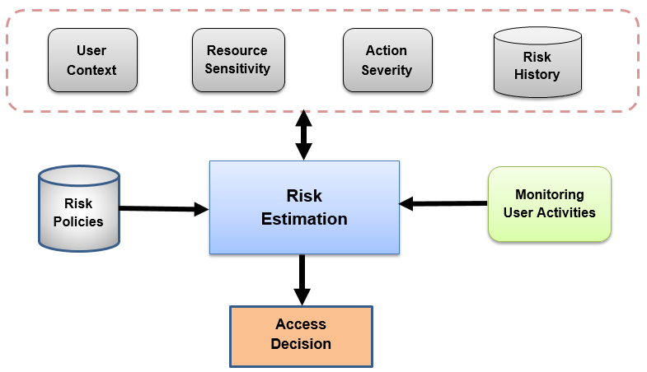
Adaptive risk-based access control model

Slide 47
Adaptive risk-based access control model
The dynamic access control approaches use dynamic environment features to reach the access decision.
One of these features is the security risk associated with the access request which will be used in our model to reach the access decision.

Slide 48
Adaptive risk-based access control model
User Context
The user context represents the environmental features that are embedded to the user during making the access request.
Location and time are the most common user contexts.
These features are used to estimate the security risk value associated with the user.
Resource Sensitivity
Resource sensitivity represents the value of the resource data. In IoT, some data is confidential, whereas other data is less important.
The model is based on assigning a risk metric for each resource in the IoT environment depending on the importance of the resource data.

Slide 49
Adaptive risk-based access control model
Action Severity
Action severity represents the consequences of a certain action on a particular resource in term of CIA security requirements (confidentiality, integrity, availability).
Different operations have different impacts and so have different risk values.
Risk history
The risk history of the user regarding a certain resource with a specific action can be used to estimate the overall risk value.
This is because risk history reflects the previous users’ behaviour patterns.
Moreover, it is used to identify good and bad authorized users and predict the user future behaviour.

Slide 50
Adaptive risk-based access control model
Risk estimation
This module is responsible for taking the input features from user, resource and action to quantify the risk value with each entity then aggregate these risk values with the user risk history to evaluate the overall numeric risk value associated with the access request.
The access decision is determined whether granting or denying the access according to the risk policies.
Risk policies
Risk policies or access control policies are mainly used by risk estimation module to make the access decisions.
These policies are created by the resource owner to identify terms and conditions of granting or denying the access.
The overall risk value is examined with the risk policies to determine the access decision.

Slide 51
Adaptive risk-based access control model
Monitoring user activities
If the access decision is granting the access to the user, then there is no way to prevent any abnormal and unusual data access from the authorized user.
So a monitoring process is needed to adaptively adjust the risk value based on the user behaviour during the access session.
The smart contract is used to accomplish this process.
The monitored user behaviour information will be compared with the risk value to ensure that the user acts according to the terms of the smart contract.

Slide 52
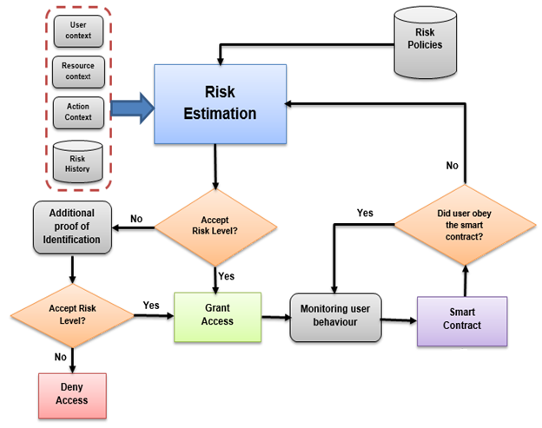
Process flow adaptive risk-based access control model

